Slide 1
Intro to Metabarcoding and lab pipeline overview
Notes:
Poll class (# ppl with samples, # ppl with no pcr experience, # ppl with 0 R), Show github links/protocol links, ask questions

Slide 2
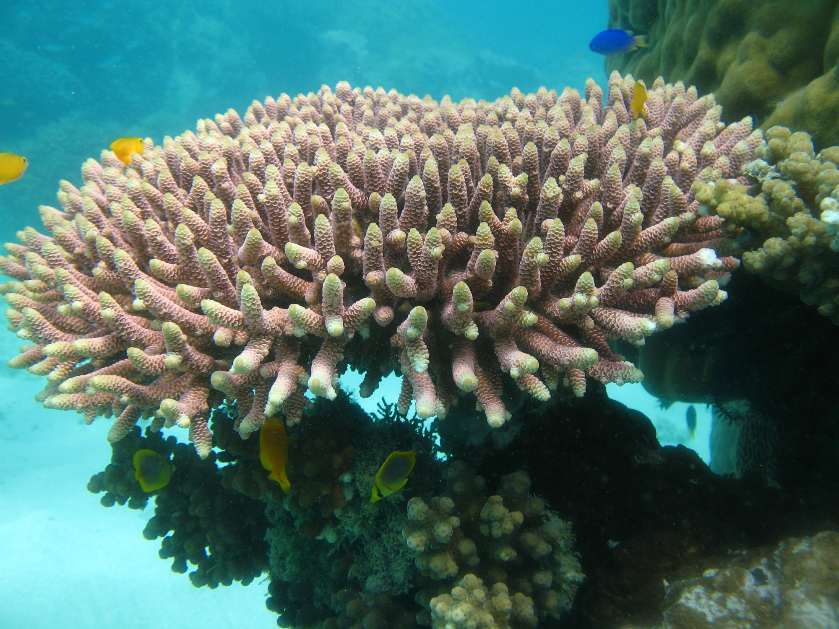
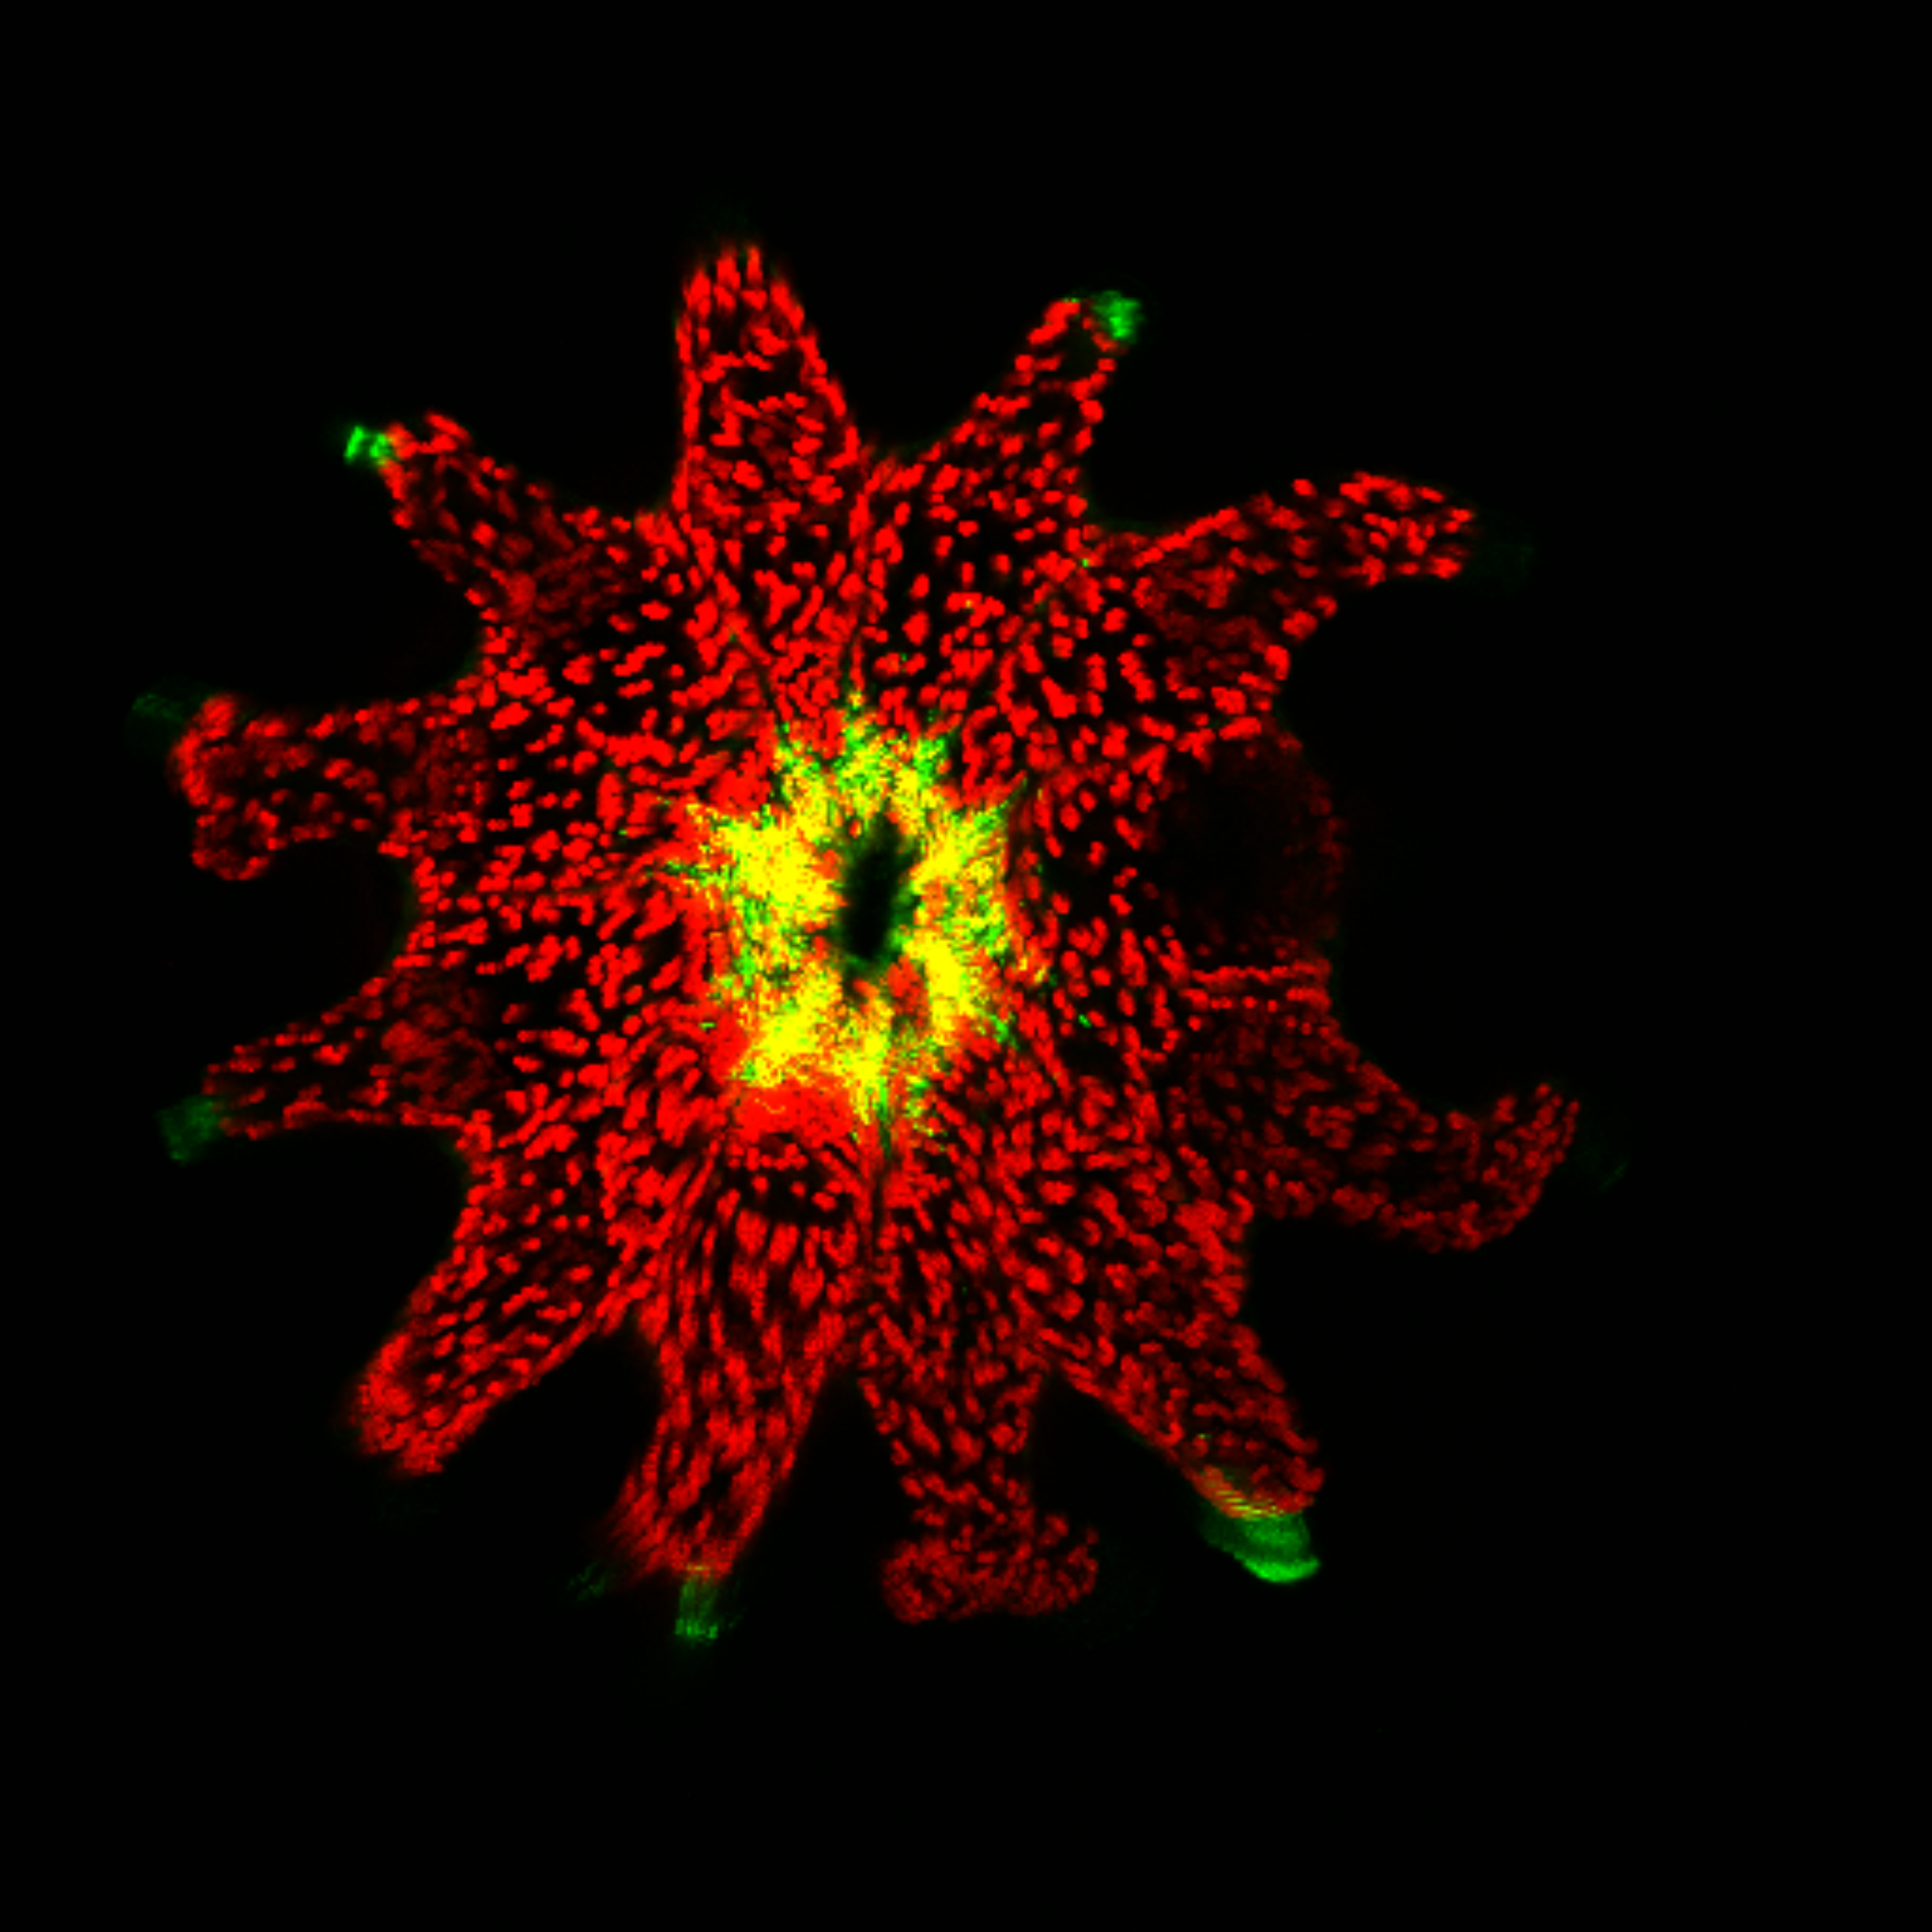
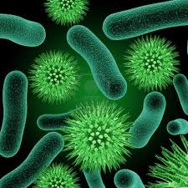
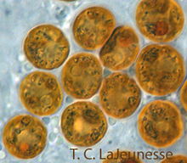
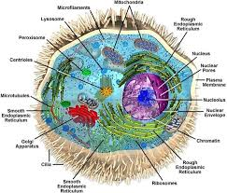
Figuring out what is present in complex communities
Bacteria
(16S)
Algae OR Fungi
(ITS2)
Eukaryotes
(18S)
How can we begin to understand how these communities differ across species, time and space?
Notes:
I didn’t understand for a long time

Slide 3
Metabarcoding and Sequencing
Isolate DNA from community (coral, plankton)
Choose your locus (ITS2, 16S, 18S)
Design specific primers for your target of interest
Use Polymerase Chain Reaction (PCR) to amplify the target
Prepare amplicon construct using additional PCR steps to attach Illumina adapters
Sequence!

Slide 4
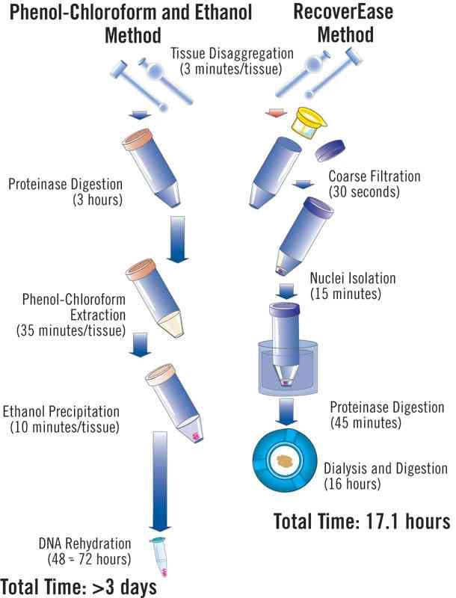
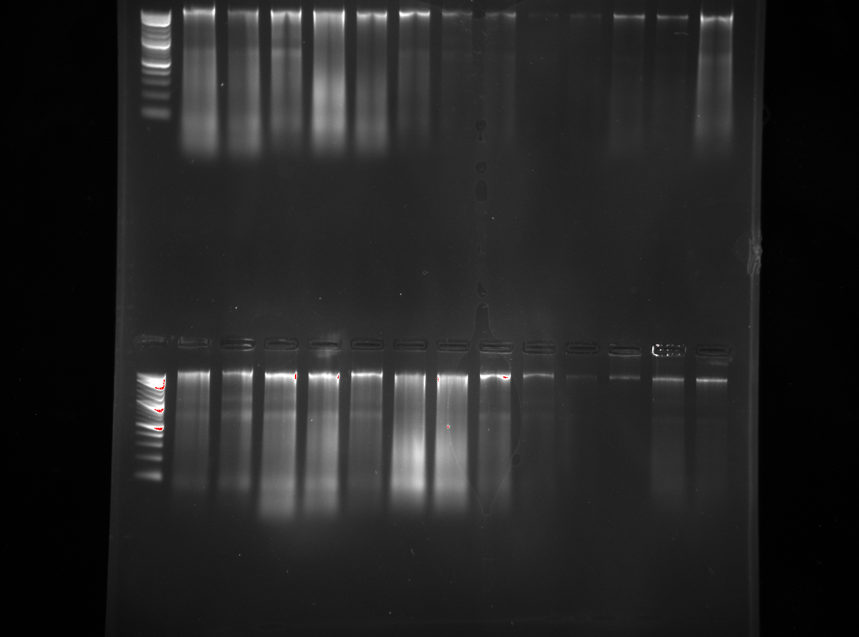
DNA Isolation
Digest DNA- Proteinase K (1 hr)
PCA → 3 rinses (1.5 hr)
Ethanol precipitation (30 mins)
DNA rehydration (15 mins)
DNA quantification → nanodrop
DNA visualization → agarose gel electrophoresis
Cost - <$0.50

Slide 5
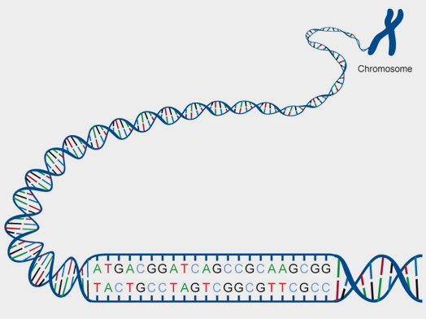
What’s a “primer”
ITS2 Region
Linker
N’s
F
R
N’s
Linker
Notes:
Explain what F, Ns and linkers are

Slide 6
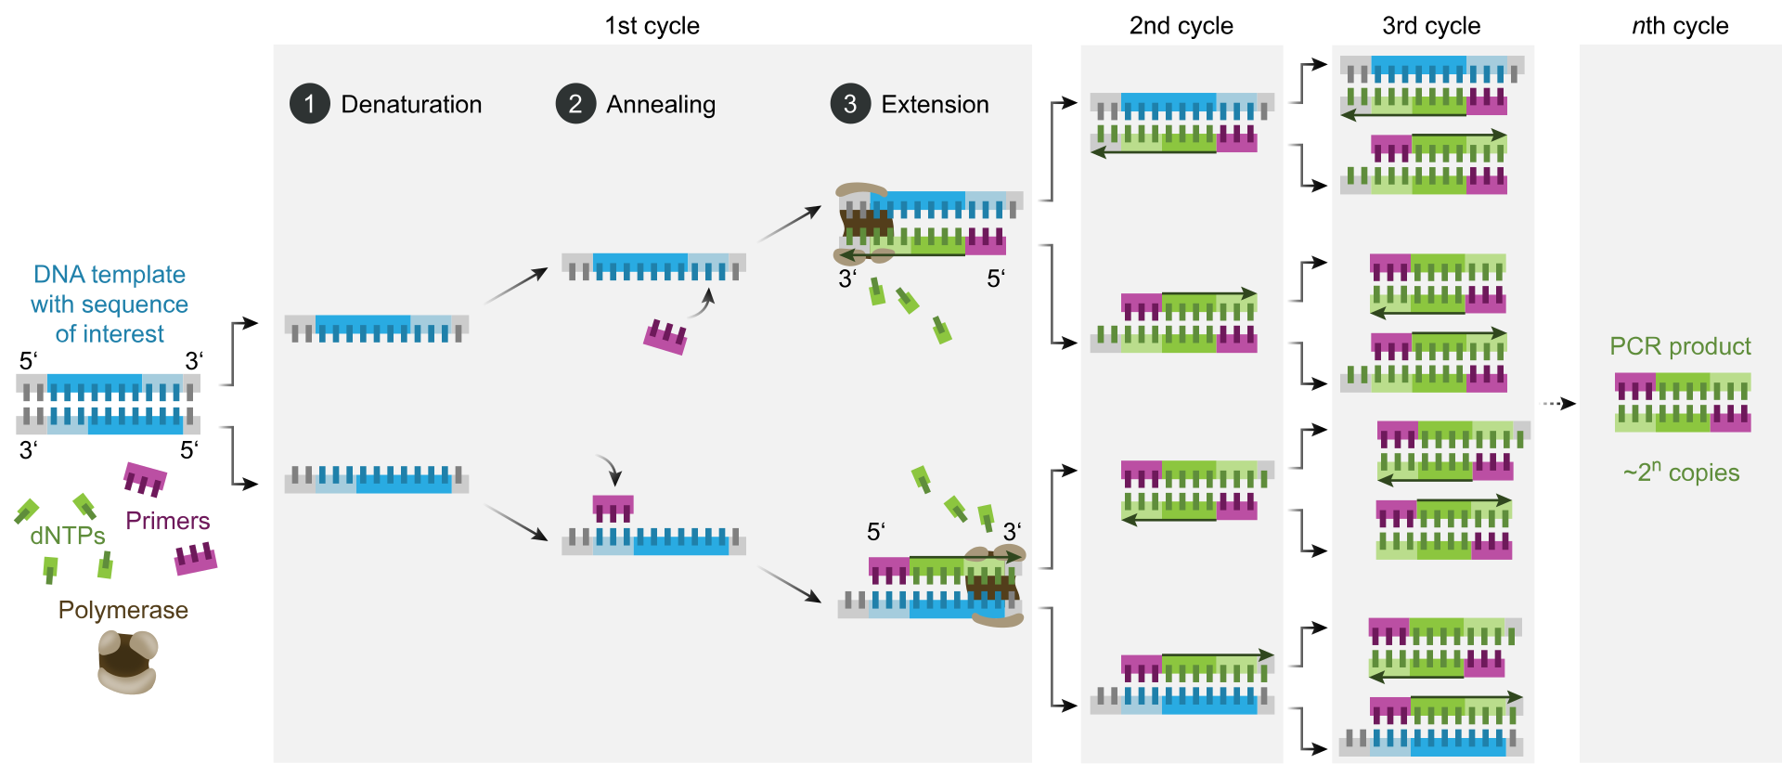
PCR Amplification

Slide 7
Cycle Checking Example 1
ITS2 Region
Linker
N’s
F
R
N’s
Linker

Slide 8
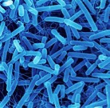
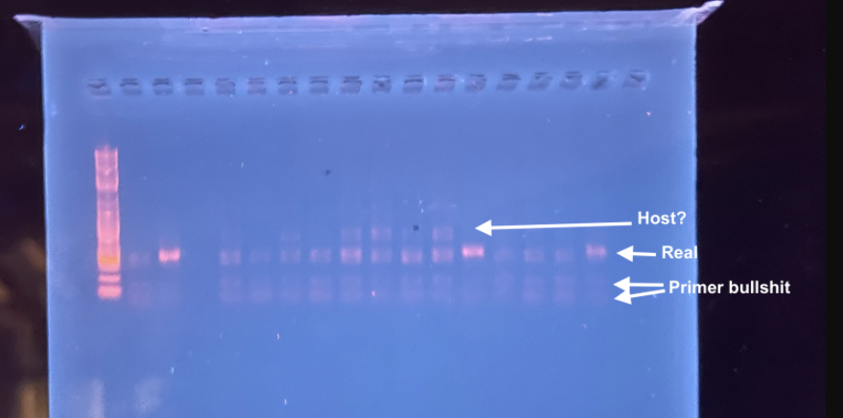
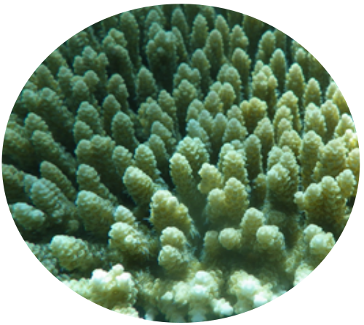
Cycle Checking Example 2
Sometimes what you amplified is messy!
Why will primers always be on the bottom of a gel? Importance of negative control & should we sequence it?
If nothing shows up you can add cycles- danger of adding cycles?
16S Region
Linker
N’s
F
R
N’s
Linker
Notes:
Sometimes its more compl

Slide 9
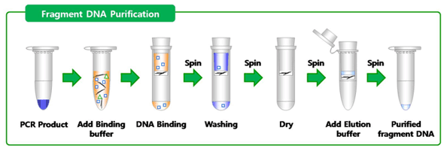
PCR Cleanup
Notes:
removes primers, dNTPs, unincorporated labeled nucleotides, enzymes, and salts from PCR and other reaction mixtures.

Slide 10
Addition of barcodes
ITS2 Region
Linker
N’s
F
R
N’s
Linker
BC
Linker
Linker
BC

Slide 11
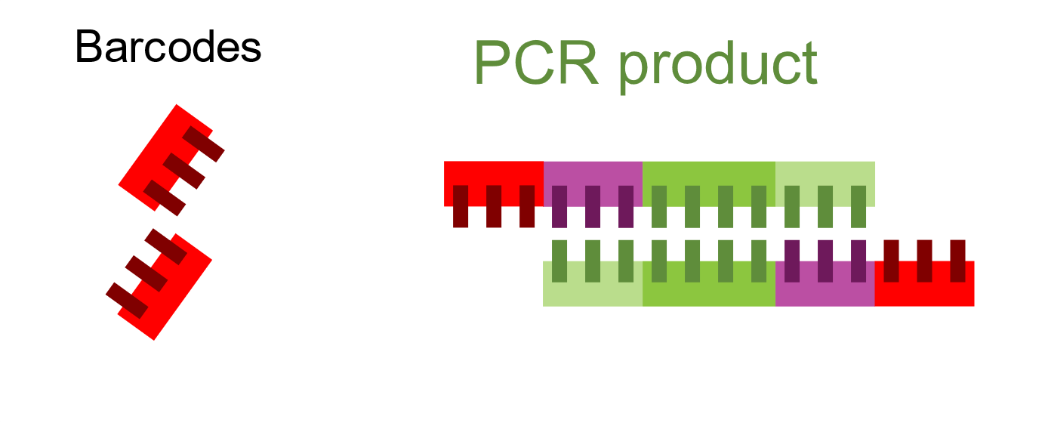
What are the barcodes for?
Sample 1
Sample 2
ITS2 Region
Linker
N’s
F
R
N’s
Linker
BC
Linker
Linker
BC
Sample 3

Slide 12
2nd PCR Amplification

Slide 13
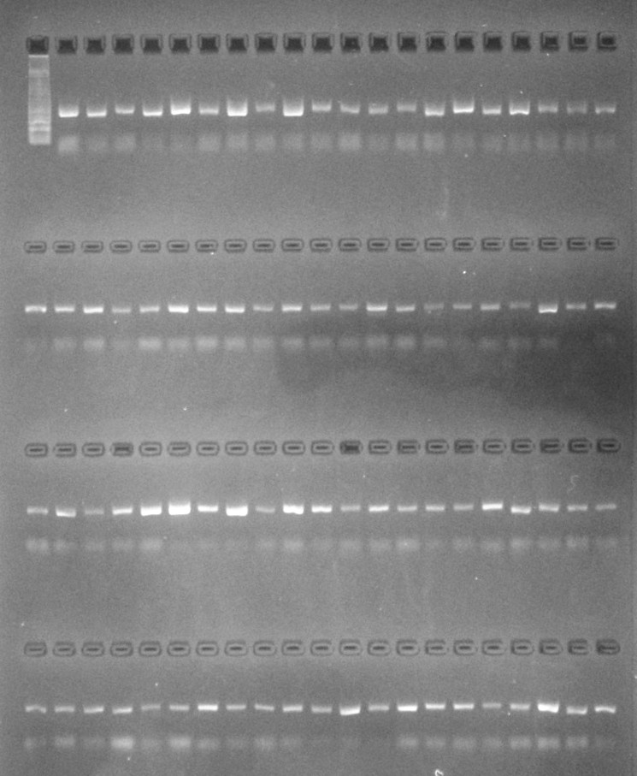
Gel pcr products

Slide 14
Pooling products
Notes:
How much to pool of each

Slide 15
PCR Cleanup for pooled samples
Notes:
removes primers, dNTPs, unincorporated labeled nucleotides, enzymes, and salts from PCR and other reaction mixtures.

Slide 16
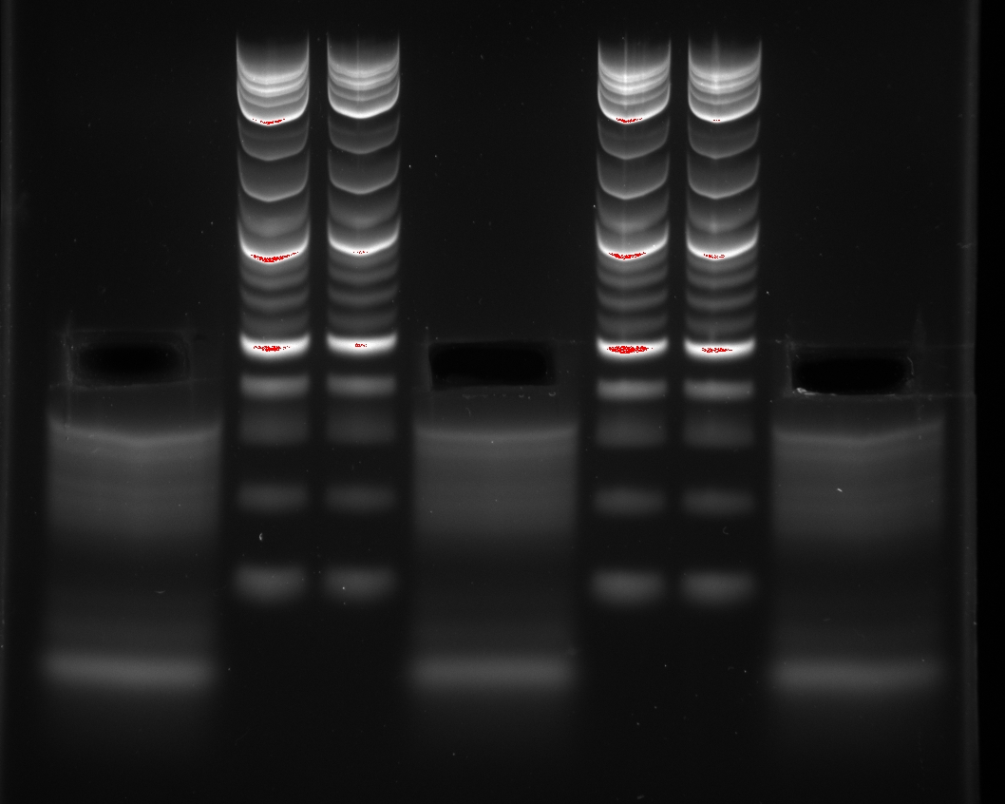
Gel extraction
Leave overnight in MilliQ

Slide 17
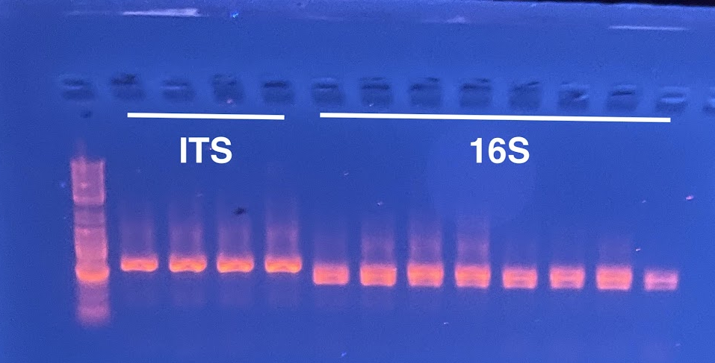
Test PCR with Illumina adapters
ITS2 Region
Linker
N’s
F
R
N’s
Linker
P5
BC
Linker
Linker
BC
P7
✓ Ready to sequence!
Notes:
These pcr products don’t get used for anything, we are just making sure that the pieces we extracted from the gel will be able to be detected by an illumina sequencing platform

Slide 18
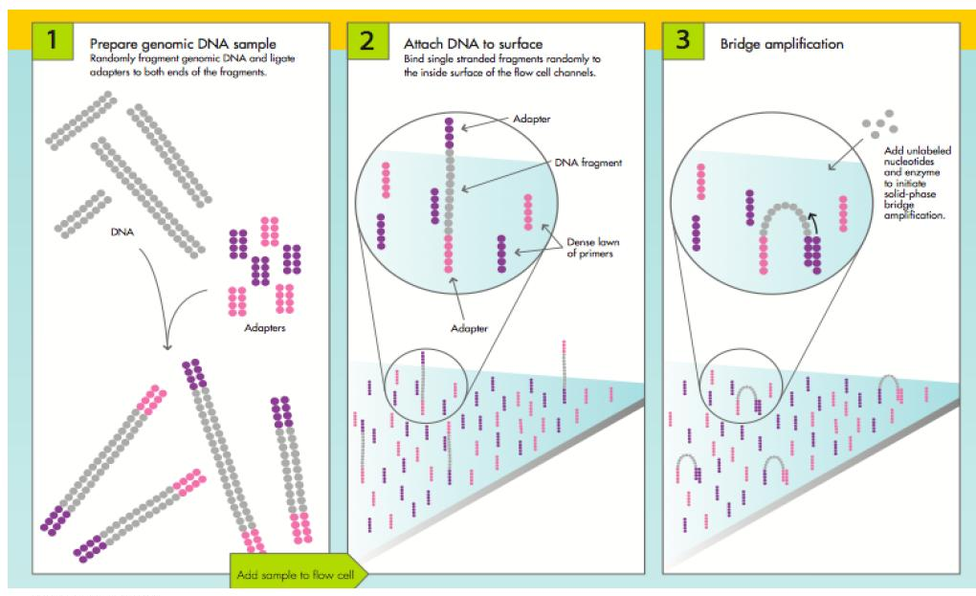
Illumina Sequencing

Slide 19
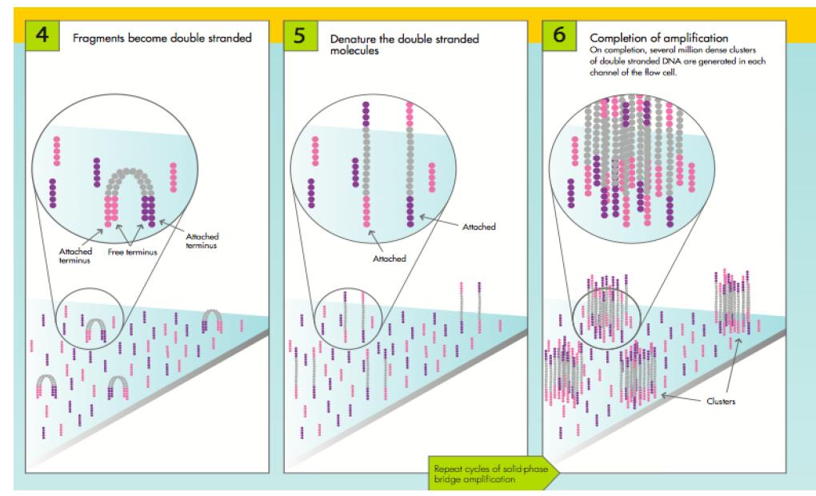
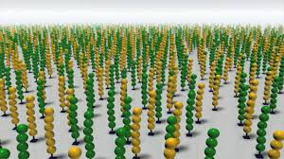
Millions of reads from Illumina

Slide 20
Illumina fastq file format

Slide 21
What to do with sequencing data
ITS2 Region
Linker
N’s
F
R
N’s
Linker
P5
BC
Linker
Linker
BC
P7

Slide 22
Isolate DNA from community (coral, plankton)
Add primer (ITS2, 16S, 18S) and PCR to amplify region of interest
Check PCR product on gel
Clean PCR products
Add barcodes and PCR
Check PCR product on gel
Pool samples
Clean pooled PCR products
Gel pooled products & gel extraction
Test PCR with P5/P7
Gel to check test PCR product
Sequence!

Slide 23
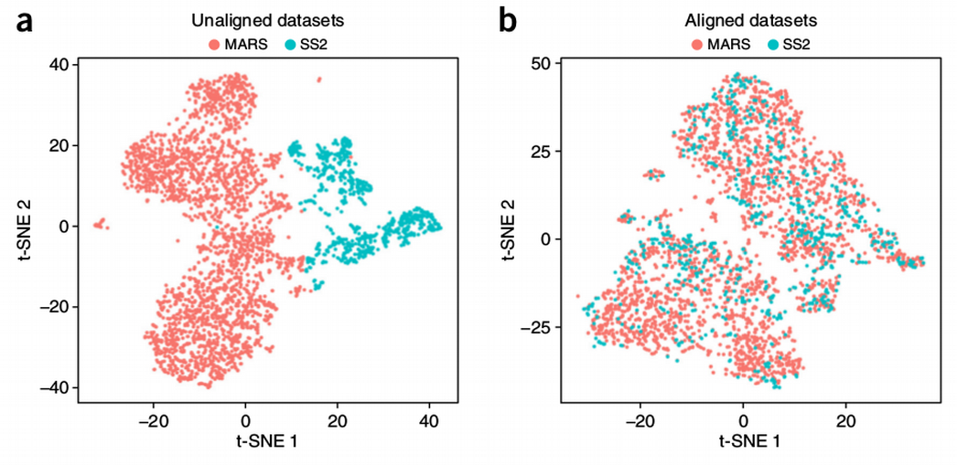
Some other random stuff
Thinking about batch effects
Markers may change depending on the question you are interested in
Can combine multiple markers in a single sequencing lane (e.g. pool ITS2 and 16S together)
Notes:
Trying to sequence everything on one plate/one lane. If you sequence across multiple lanes carry over some samples.

Slide 24
Some other random stuff
Think about batch effects
Markers may change depending on the question you are interested in
Can combine multiple markers in a single sequencing lane (e.g. pool ITS2 and 16S together)
Notes:
And finally, I created haplotype networks with the reference sequences.

